Slide 1
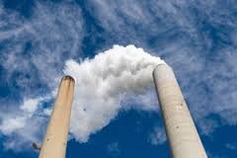
SURVEY OF INDUSTRIAL ACCIDENTS THEIR CAUSES AND PREVENTIVE MEASURE.
GROUP 17
SHARVARI DABHADE- 13CHE1068
VISHAL JADHAV -13CHE1069
TANMAY GAIKWAD -13CHE1070
AKSHAY JADHAV- 13CHE1071
AVIRAL KOTANGLE- 13CHE1073

Slide 2
OVERVIEW
Need Of The Topic
Brief Introduction
Major Accidents
Preventive measures & Policies
Risk Control Measures
Conclusion

Slide 4
Industrial Accidents
Living Organisms
Environment
Property
Immediate, Short-term
and Long-term Effects
Humans Livestock Plants
Soil and Water Bodies
Atmosphere
Death, Injury, Disease and Disability
Pollution

Slide 5
Some major accidents in chemical industries

Slide 6
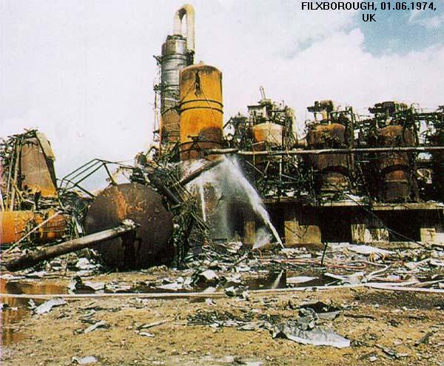
FILXBOROUGH, 01.06.1974, UK

Slide 7
ACCIDENT OVERVIEW
A temporary pipe was fitted between two sequential reactors in a plant that was oxidising cyclohexane at elevated temperature and pressure.
The pipe was not designed properly and the mechanical loads acting on the pipe were not correctly identified.
In particular the pipe was subject to large bending loads for which it had not been designed.
The pipe broke open at a thermal expansion bellows fitting in the line.
Large amounts of liquid cyclohexane escaped through the ruptured pipe and vaporised.
The vapour cloud found an ignition source and a fireball ensued.

Slide 8
PROCESS DESCRIPTION & REACTOR CONFIGURATION
The Flixborough petrochemical plant was involved in the production of cyclohexanone, a precursor for the manufacture of Nylon. The raw material cyclohexane was oxidised to cyclohexanone by injecting air in the presence of a catalyst.
The process of oxidation is slow and it was decided to use six stirred reactors in series with the product from the first overflowing into the second and so on. To do this the reactors were mounted on a platform arranged in a series of steps each 0.355 m higher than the one following.
Good reaction kinetics dictated that the cyclohexane in the reactors be maintained at the elevated temperature of 155 °C. This temperature is above its boiling point at atmospheric pressure so to hold it a liquid state, the reactors had to be operated at 9 bar pressure.

Slide 9
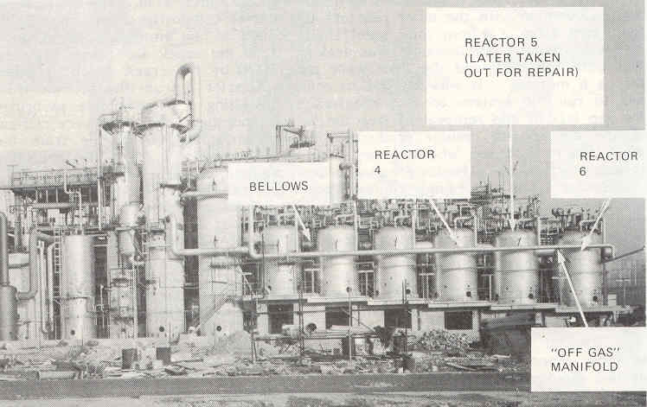
REACTOR CONFIGURATION

Slide 10
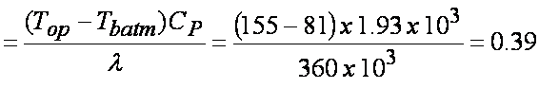
Any loss of containment would produce large scale flashing and escape of flammable vapour!
In other words if any part of the reactor wall or associated piping broke, the pressure would suddenly fall from 9 bar to 1 bar (atmospheric pressure) and a huge amount of cyclohexane vapour would be generated.
Considering an adiabatic energy balance:
energy consumed in evaporating off vapour is provided by cooling of the liquid fraction from 155 °C down to 81 °C.
Fraction Evaporated
About 40 % of the cyclohexane will vaporize. Given the inventory of cyclohexane in the reactor train was about 100 tonnes, thus in the event of an accident, 40 tonnes of vapour would be released.
Being heavier than air, cyclohexane if released would form a cloud in the shape of an up-turned bowl. At the centre of the cloud, the vapour would be close to pure cyclohexane but at the fringes, where it is mixed with air, the concentration could lie in the flammable range.

Slide 11
CONTAINMENT DESCRIPTION
An unwanted by-product of the oxidation reaction were some very corrosive acids, which could only be contained by stainless steel. However stainless can be 10 times the price of mild steel so the solution was to make the reactors out of 12.5 mm thick mild steel with the reactor insides lined with 3 mm thick stainless steel
The reactors were vertical cylindrical vessels with a diameter of approximately 3 m and height of 6 m. The outsides were lagged with thermal insulation protected by aluminium cladding.
Each reactor was adjoined to the adjacent reactors by a short stub pipe of 0.7 m diameter. Due to the close proximity of the reactors to each other, the length of this stub pipe was only about 1.5 m
There were a number of pressure relief valves in the system set to lift at 11 bar.

Slide 12
INCIDENT DESCRIPTION
Sometime in March 1974, cooling water was sprayed on the outside of Reactor 5 to quench a minor leak from a valve. However the water was contaminated with chemicals which corroded the mild steel casing of the reactor. The fact that the steel shell was under a tensile hoop stress due to the contained pressure would have accelerated the damage (a phenomenon known as stress corrosion).
This corrosion had the result that more of the mechanical load was transferred to the stainless steel liner which was then overstressed and it in turn cracked. Cyclohexane vapour began to leak from the reactor.
A first lesson of this would be that the system could leak as a result of external corrosion (presumably not considered due to the lagging).

Slide 13
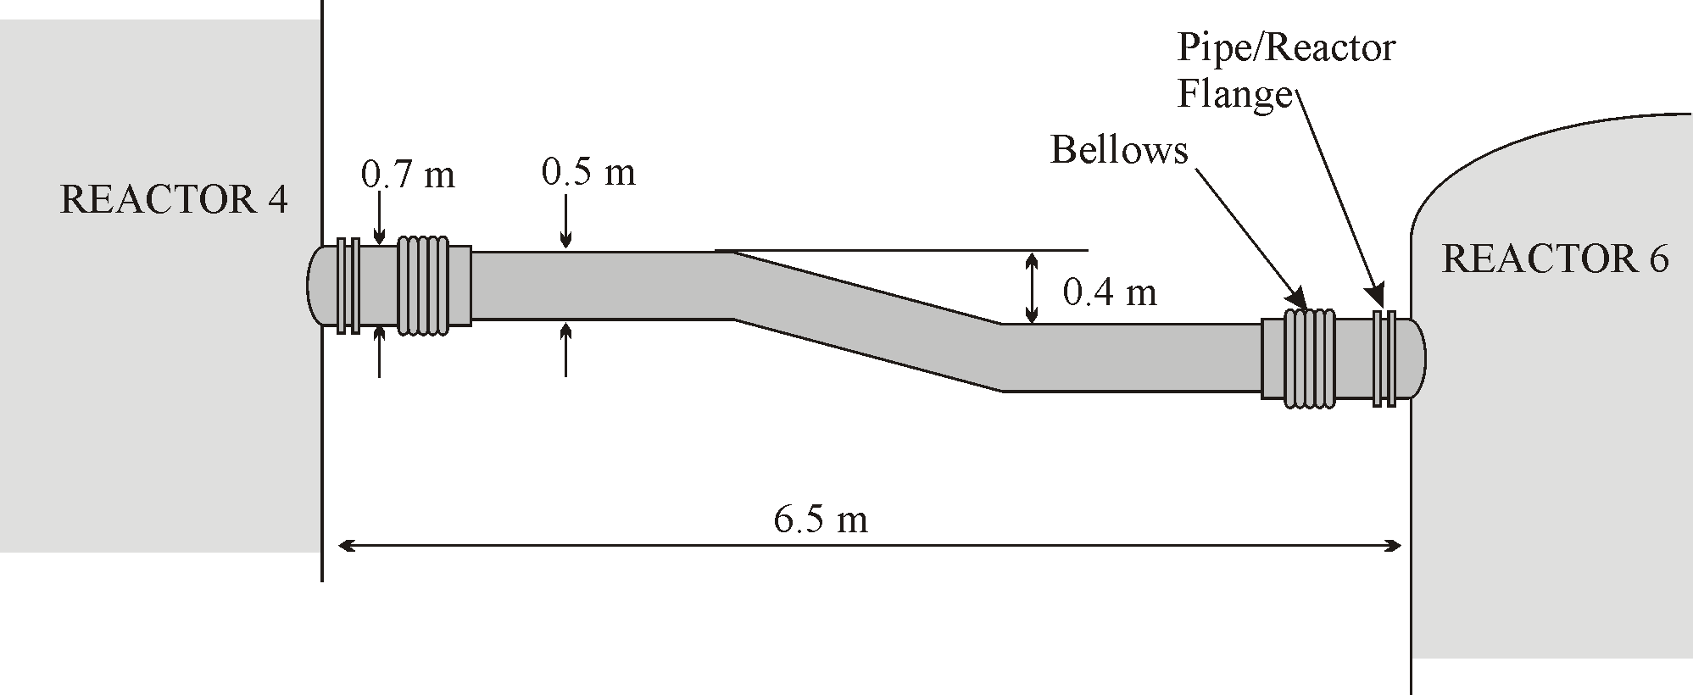
INCIDENT DESCRIPTION
This reactor had to be shutdown and removed from service for repair. To keep the process running, it was decided to fabricate a temporary by-pass pipe to join Reactor Number 4 to Reactor Number 6.
POOR MECHANICAL DESIGN OF THE BY-PASS PIPE WAS THE REASON FOR THE DISASTER
The by-pass pipe itself had a bore of 0.5 m though the stub pipes emanating from both reactors were of a larger diameter of 0.7 m. There were two bellows in the stub pipes to permit axial expansion or contraction of
pipework.

Slide 14
MEMBRANE STRESS DUE TO FLUID PRESSURE
Because the pipe between the two reactors contains a pressurized fluid, stresses will be developed in its walls.
Fluid Pressure P = 9 bar
Pipe Diameter D = 0.5 m
Pipe wall thickness t = 0.006 mm (In fact this is a guess; 6 mm is ¼ inch)
The hoop (circumferential) stress will be:
Also have longitudinal stress in the pipe wall
These were the only stress calculations carried out!
There was (and is) a piping design code which requires more rigorous calculations and tests to be carried out on new piping. However (unlike vessels) compliance with the code is not legally binding.

Slide 15
BELLOWS REQUIREMENT
Thermal expansion
For a straight pipe with no bellows and assuming the reactor vessels at either end act as perfectly rigid restraints, the induced thermal stress, σ_{T} assuming there is no accommodation of thermal expansion will be
This is a compressive stress and is of such a magnitude as to certainly cause damage to the pipe.
To avoid any thermal stress, the bellows must allow free axial thermal expansion of an amount
Weight Loading
The normal span of the pipe running between adjacent reactors was something over 1 m. However between Reactors 4 and 6 a span of 6.5 m was present. Thus bending due to weight loading (sagging) may be significant.

Slide 16
CALCULATIONS
Pipe inside diameter D_{i} = 0.5 m
Pipe outside diameter D_{o} = 0.5 + 2 x 0.006 = 0.512m
Pipe length L = 6.5 m
Steel density ρ_{s} = 7800 kg/m³
Cyclohexane density ρ_{p} = 780 kg/m³
^{W=(1021+484)*9.81 = 14764 N}
Bending Moment Calculation:
The pressure forces, F_{p} are:
=346 KN
The magnitude of the uniformly distributed load, q is

Slide 17
BEAM ANALYSIS OF BY-PASS PIPE
Equilibrium of Vertical Forces :-
Equilibrium of Moments about end A :-
The above calculations indicate that the bellows at the lower end of the pipe (adjacent to Reactor Number 6) was exposed to a non-axial (in fact a perpendicular or transverse) force of almost 30 kN.
This was agreed as being the probable cause of failure.

Slide 18
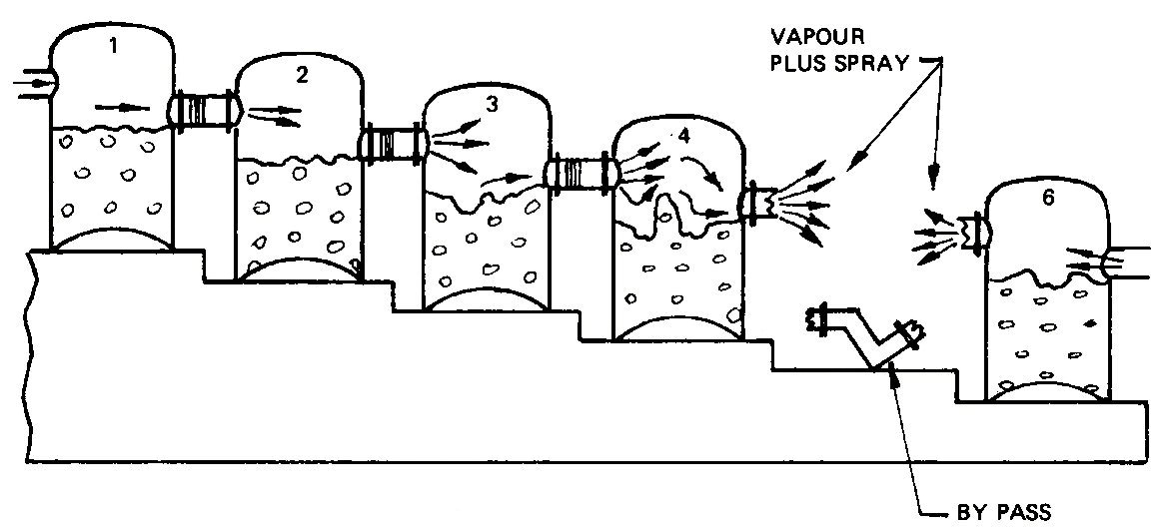
This schematic view indicates the basis of the incident
RESULT:
28 workers were killed and 36 injured on the site.
53 people were injured off-site.
1821 houses were damaged.
LESSONS
The accident occurred due to:
Poor Process Design
Lack of Understanding of Mechanical Loading of Process Equipment

Slide 19
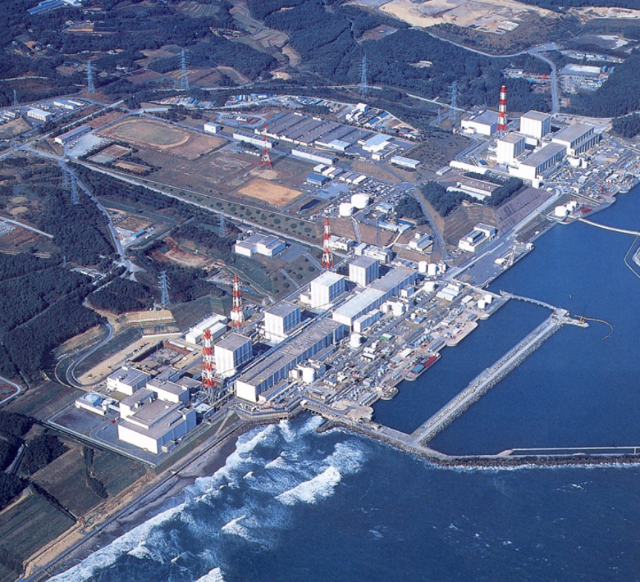
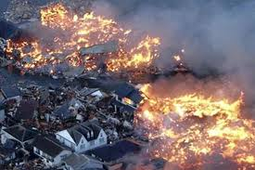
FUKUSHIMA DAIICHI NUCLEAR DISASTER
BEFORE
AFTER

Slide 20
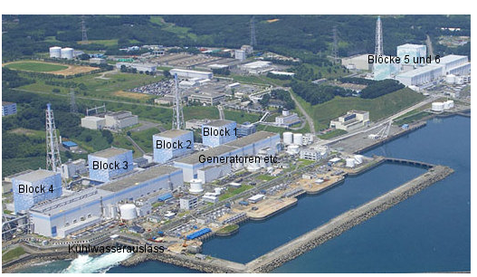
FUKUSHIMA DAIICHI POWER PLANT
Fukushima Daiichi plant comprised of six separate nuclear reactors. All reactors were water boiled type, maintained by Tokyo Electric Power Company TEPCO.
The plant was protected by a seawall protection designed to withstand a 5.7 m tsunami. Obviously this was not enough high to protect against tsunami on 11.03.2011.
The sister plant is located to the south and also run by TEPCO

Slide 21
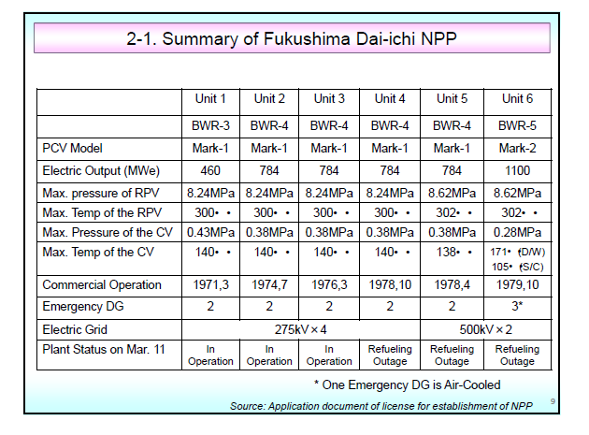
PARAMETERS OF POWER PLANT

Slide 22
ACCIDENT CAUSE
11/03/2011, 2:46 p.m. local time near the Japanese island of Honshu was an earthquake of 9 on the Richter scale.
The quake had an impact on section of north-east coast of Japan where they are located a series of nuclear power plants (NPP).

Slide 23
SITUATION AT THE TIME OF THE QUAKE
Reactor 4 had been de-fueled.
Reactors 5 and 6 were in cold shutdown state for planned regular maintenance (refueling).
Reactors 1,2 and 3 were operating.
At the moment of the quake, reactors got shut down automatically.
Emergency generators started to run to pump the water needed to cool the reactors.

Slide 24
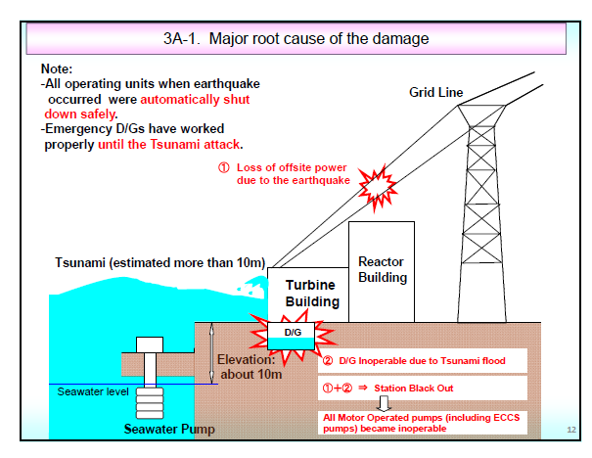

Slide 25
OVERHEATING OF REACTORS AND SPENT FUEL POOL
There were three independent cooling systems.
All the three cooling systems failed because the connection to the electricity was interrupted.
Independent cooling based on generators was failed. also broken, because they were flooded by tsunami.
Reactors and spent fuel pool started to heat. due to the radioactive decay of fission products.
Soon after the tsunami, there was a partial core meltdown in reactors 1, 2, and 3.

Slide 26
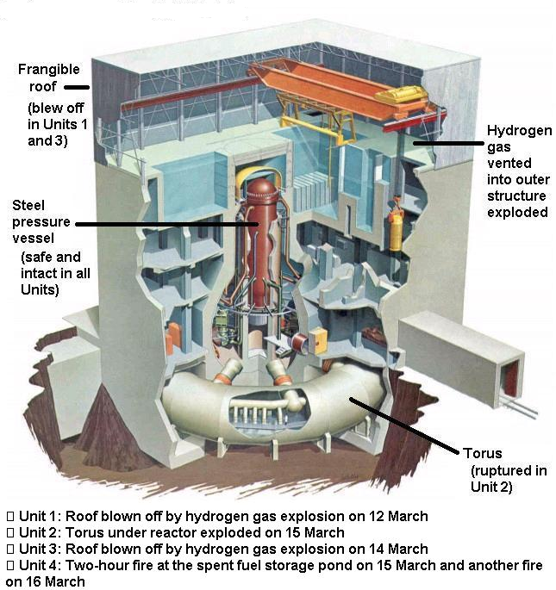
ANATOMY OF FUKUSHIMA DAIICHI BLASTS

Slide 27
EXPLOSIONS AND FIRES
Hydrogen formed in chemical reactions exploded and destroyed the Upper cladding of the housing buildings of reactors 1, 3, and 4 was destroyed.
Explosion on reactor 3 severely damaged reactor building 4.
Hydrogen leak started from reactor 3 to 4 through underground tunnels.
There was an explosion and reactor 2 caught fire.
Spent fuel rods stored in spent fuel pools of units 1–4 began to overheat as water levels in the pools dropped.
Constant production of heat also due to gamma and beta radioactive decay of fission product.

Slide 28
MANAGING OF THE ACCIDENT
Evacuation of population within 20 km, immediately after the accident.
The main problem was to enable cooling of all damaged reactors and spent fuel pools.
In order to cool down Units 1, 2 and 3 fresh water was continuously injected both via the feed water system lines and the fire extinguishers lines into the reactor pressure vessel
Temperatures and pressures were stabilized.
Sea water was used in the first phase of the accident, but it caused contamination of sea water.

Slide 29
DAMAGE CONTROL
TEPCO started work on 9 May of 2011 to install a supporting structure for the floor of the spent fuel pool of Unit 4.
Fresh water was injected into the spent fuel pools of Units 1 - 4.
One generator at unit 6 was restarted on 17 March allowing some cooling at units 5 and 6 which were least damaged.
Grid power was restored to parts of the plant from 20 March, but machinery for reactors 1–4 was damaged by floods, fires and explosions remained inoperable.

Slide 30
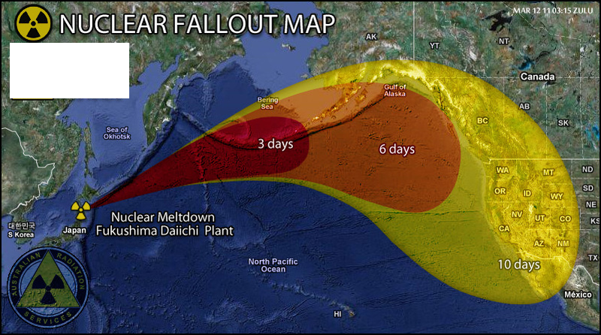
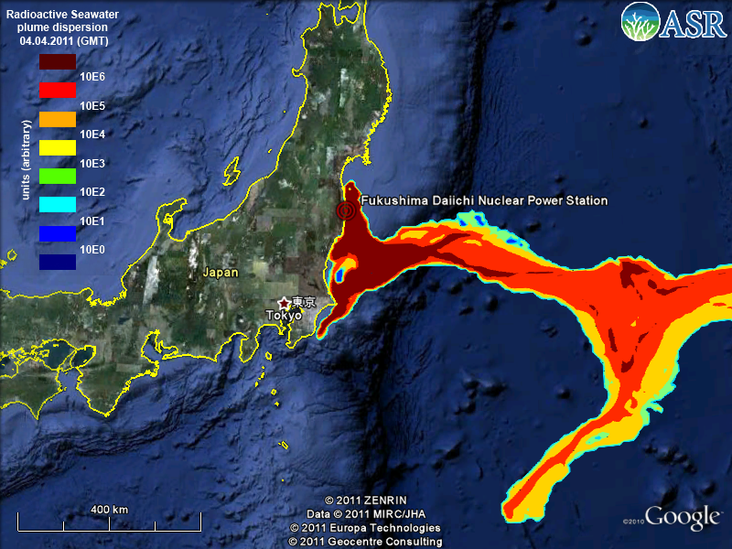
SPREAD OF RADIOACTIVE CONTAMINATION
The disaster disabled the reactor cooling systems, leading to releases of radioactivity and triggering a 30 km evacuation zone surrounding the plant; the releases continue to this day

Slide 31
CONTAMINATION
Large scale releasing of radioactivity in environment.
Fission product, ¹³¹I, ^{137,134}Cs, ^{131,134}Xe detected soon after the accident, constituted large part of radioactivity released in environment.
Contamination of sea water spread by ocean stream.
Airborne contamination by permanent atmospheric motion.
Effective dose for population around power plant was estimated up to 30 mSv much larger than dose limit of 1mSV .

Slide 32
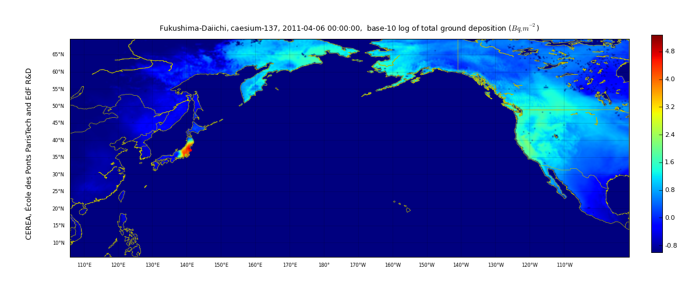
CAESIUM-137
Radioactive contamination was observed in many parts of the northern hemisphere, including Europe, Central Asia, North America.
General conclusion is that radioactivity level in Europe is rather small, and somewhere below detection limit.

Slide 33
COMPARISON

Slide 34
AFTERMATH
Japanese authorities declared the 20 km evacuation zone a no-go area which may only be entered under government supervision.
In April 2012, Units 1-6 were decommissioned.
On August 7, 2013, Japanese officials said highly radioactive water was leaking from Fukushima Daiichi into the Pacific Ocean at a rate of 300 tons (about 272 metric tons) per day.
On 1 August 2013, the Japanese Industry Minister Toshimitsu Motegi approved the creation of a structure to develop the technologies and processes necessary to dismantle the four reactors damaged in the Fukushima accident.
In December 2013 TEPCO decided none of the undamaged units will reopen.

Slide 35
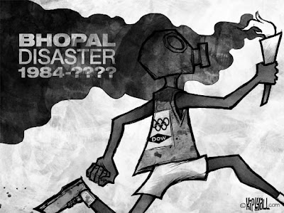
BHOPAL GAS TRAGEDY

Slide 36

OUTLINE
Introduction
How did it starts
Affected area
Factors involved for leak
Overall gas leak summary
Other causes

Slide 37
THE TRAGEDY
Bhopal gas tragedy, a disaster that happened by a Gas leak .
Occurred on the night of December 2–3, 1984 at the Union carbide India Limited (UCIL) Pesticide plant in Bhopal, Madhya Pradesh, India.
A leak of Methyl Isocyanate (MIC) gas and other chemicals from the plant resulted in the exposure of thousands of people.
The official immediate death toll was 2,259 and the government of Madhya Pradesh has confirmed a total of 3,787 deaths related to the gas release .

Slide 38
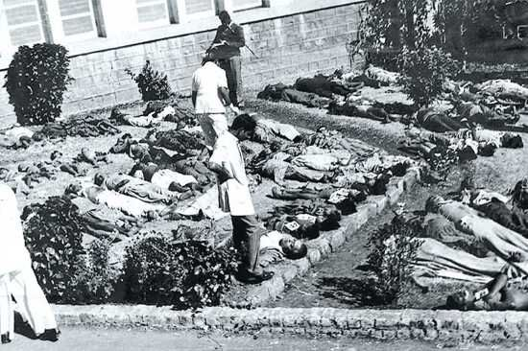
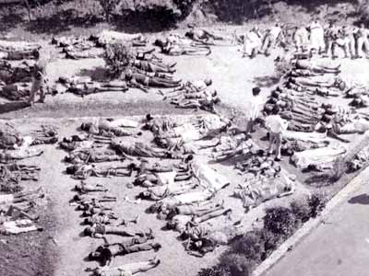

Slide 39
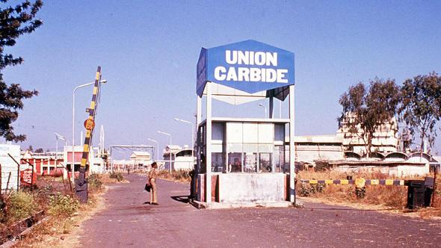
UNION CARBIDE INDIA LIMITED
UCIL was the Indian subsidiary of Union Carbide Corporation (UCC), with Indian Government controlled banks and the Indian public holding a 49.1 percent stake.
It started in 1969 at the northern state of India.
Phosgene, Monomethlyamine, Methyl Isocyanate (MIC) and the pesticide Carbaryl, also known as Sevin were manufactured here.

Slide 40
HOW DID IT START
To produce Pesticide Sevin with an intermediate methyl isocyanate (MIC).
It necessitated the start up of MIC production plant in 1979.
Following production continued ,ironically during the night of December 2–3, 1984, water entered Tank E610 containing 40 tons of MIC.
The resulting in exothermic reaction which increased the temperature inside the tank to over 200 °C(392 °F) and raised the pressure.
About 30 metric tons of methyl isocyanate (MIC) escaped from the tank into the atmosphere, which got added to a weak wind which frequently changed direction, which in turn helped the gas to cover more area in a shorter period of time (about one hour).

Slide 41
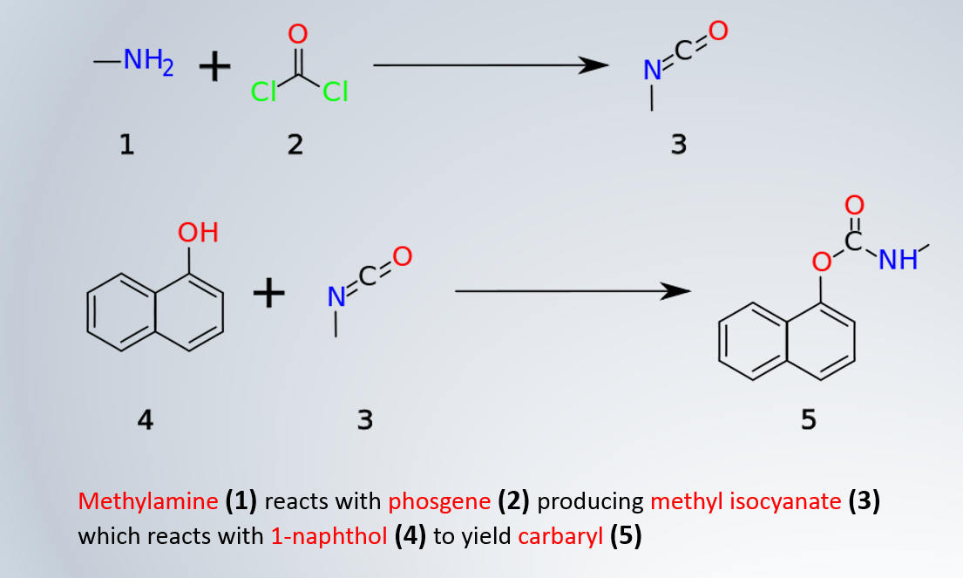

Slide 42
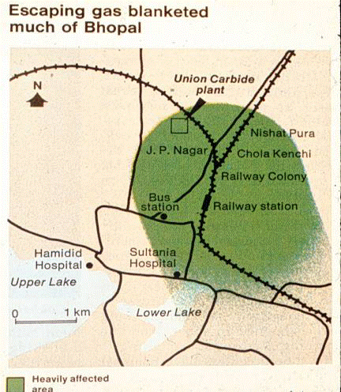
AFFECTED AREA

Slide 43
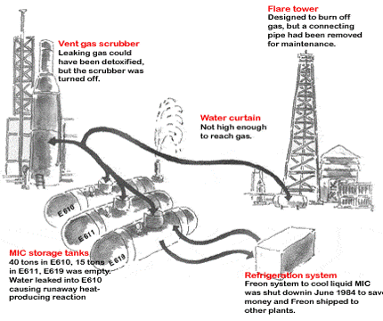

Slide 44
WHAT FACTORS LEAD TO THE MAGNITUDE OF GAS LEAK??
Storing MIC in large tanks and filling beyond recommended levels.
The flare tower and several vent gas scrubbers had been out of service for five months before the disaster.
Failure of several safety systems .
Also some safety systems being switched off to save money, including the MIC tank refrigeration the MIC was kept at 20 degrees Celsius, not the 4.5 degrees advised by the manual.
There was only one manual back-up system, compared to a four-stage system used by union carbide plant of USA.
Lack of skilled operators-No proper training was given to them.

Slide 45
OVERALL VIEW OF THE GAS LEAK
The scientific reason that caused the accident was that water entered the tank where about 40 cubic meters of MIC was stored.
As a result, the safety valve of the tank burst because of the increase in pressure.
It is presumed that between 20 and 30 tonnes of MIC were released during the hour that the leak took place.
The gas leaked from a 30 m high chimney and this height was not enough to reduce the effects of the discharge.

Slide 46
OTHER CAUSES
Use of more dangerous pesticide manufacturing method for decreasing the generation cost.
Plant located very close to a densely populated area.
Lack of skilled operators.
Reduction of safety management.

Slide 47
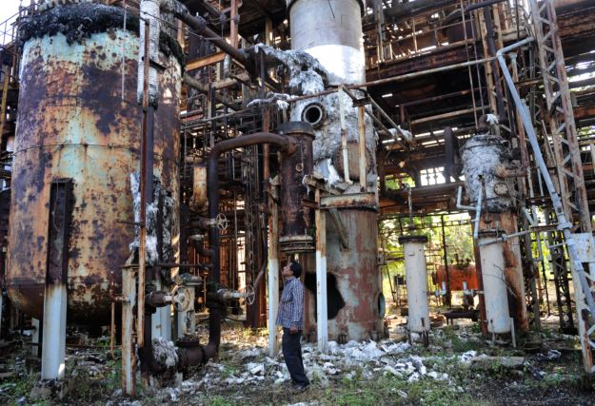
UCIL PLANT AFTER DISASTER

Slide 48

GEORGIA SUGAR REFINERY EXPLOSION

Slide 49
INTRODUCTION
The 2008 Georgia sugar refinery explosion was an industrial disaster that occurred on February 7, 2008 in Georgia, United States 14 were killed and 42 injured when a dust explosion occurred at a sugar refinery owned by Imperial sugar.
It is considered to be the biggest accident due to dust explosion.
Similar such accident occurred on 21 July 2003 a dust explosion occurred in the Sugar Silo Facility at British Sugar refinery in Cantley, Norfolk. The plant was not operational at the time of the explosion and was actually undergoing maintenance.

Slide 50
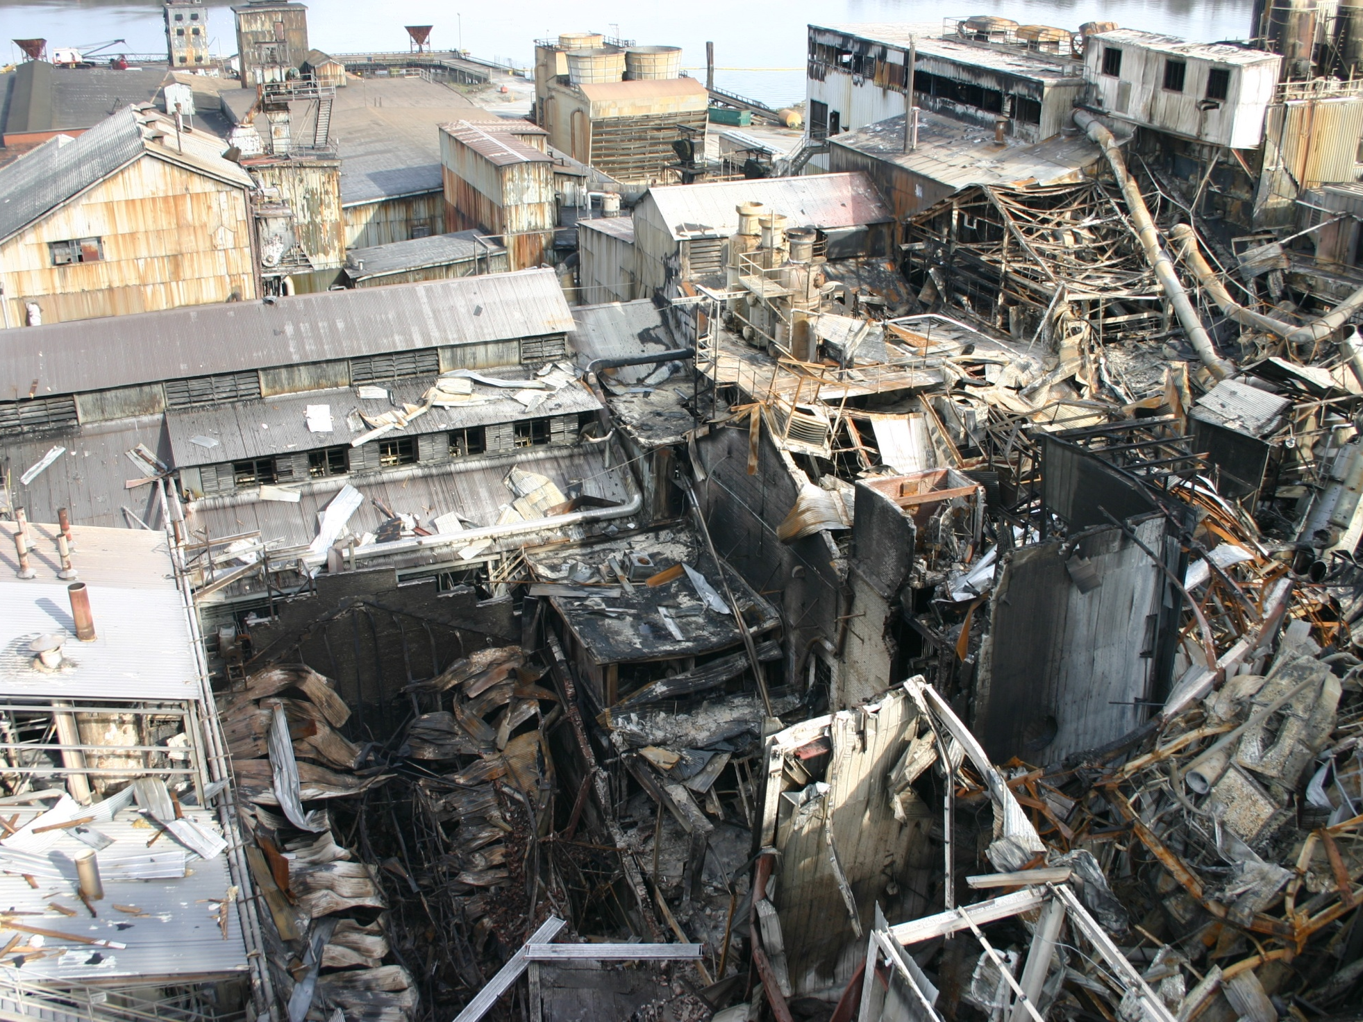

Slide 51
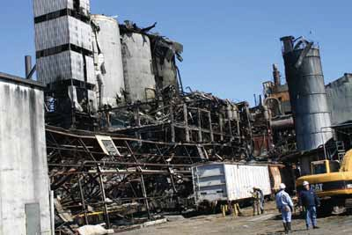

Slide 52
CHEMISTRY BEHIND THE EXPLOSION
Burning sugar—chemically known as sucrose (C12H22O11) produces energy almost immediately and we know that sugar ignites and burns like a torch.
This process, called combustion, is described by the following chemical reaction:
C12H22O11 (solid) + 12 O2 (gas) ➔ 12 CO2 (gas) + 11 H2O (gas) + energy

Slide 53
SOME MORE CHEMISTRY!!
There are 12 moles of gas on the left side of the equation for the combustion of sugar but 23 moles of gas on the right side. This explains the increase in volume is typical in explosive reactions.
Thus the volume needs to increase rapidly for an explosion to occur.

Slide 54
THE CATCH!!
So, why doesn’t sugar explode or at least light on fire when we eat it??
In the process respiration, sucrose is first digested in the stomach into its component sugars, one of which is glucose.
Glucose subsequently reacts with oxygen in a series of small steps within our cells.
This reaction occurs at a slower rate and the energy is stored, so no explosion occurs.

Slide 55
FACTORS THAT AFFECT THE RATES OF CHEMICAL REACTION:
Nature of the reactants, their physical state (solid, liquid, gas) the surrounding temperature and pressure, and the amount of surface area.
The most important factor is the amount of surface area.
As raw sugar is refined, it is ground into smaller particles.
Sugar particles in granulated sugar range in size from 570 to 635 micrometers.
In powdered sugar, the particles are much smaller; Their average size is 60 micrometers.

Slide 56
As the surface area increases, the number of collisions between the molecules on the surface and the oxygen molecules in the air increases. That’s what occurs when dust is dispersed in the air, each dust particle is surrounded by oxygen molecules, so collisions occur between these dust particle and surrounding oxygen molecules.
In the presence of a spark or a flame, all of these collisions become combustion reactions that occur at a very rapid rate. Lots of heat is released, which quickly causes a very rapid increase in the volume of the gases being formed, creating a shock wave—a series of air waves that move very fast—typically explosions.

Slide 57
THE DISASTER
Exhaust systems were inadequate to keep the dust out of the air. A spark or flame from one of the machines in the plant started the explosions, which quickly spread to other parts of the facility.
As the explosions tore the plant apart, sugar dust that had collected on the floor and equipment was tossed into the air and quickly added to the explosions.

Slide 58
PREVENTION OF DUST EXPLOSIONS
Prevent dust suspensions - dust collectors must be installed
Add moisture - moister dust requires a higher ignition energy and is less likely to be swirled up and explosion can be prevented.
Reduce concentration of flammable substances below LCL(low combustible limit)
Reduce oxygen conc.- dust gets combusted in presence of high oxygen conc.
Eliminate ignition sources - sources which can come in contact of dust.

Slide 59
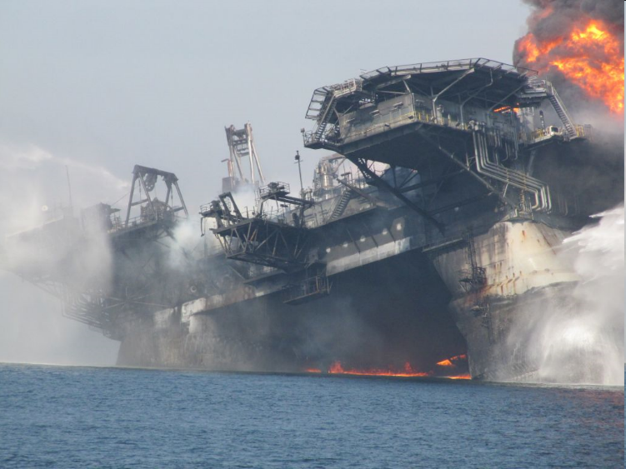
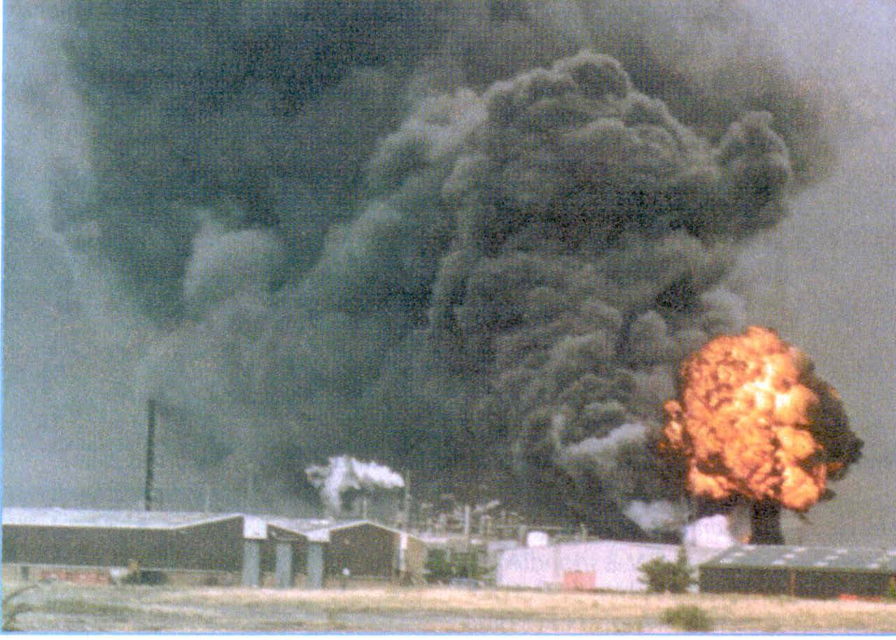
THEY THOUGHT THEY WERE SAFE….
“Good” companies can be lulled into a false sense of security by their performance in personal safety and health
They may not realize how vulnerable they are to a major accident until it happens
Subsequent investigations typically show that there were multiple causes, and many of these were known long before the event
BP Deepwater Horizon
Epichlorhydrin fire,
Avonmouth, UK

Slide 60
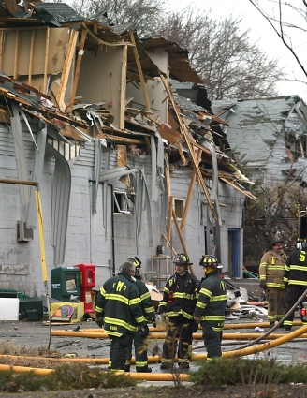
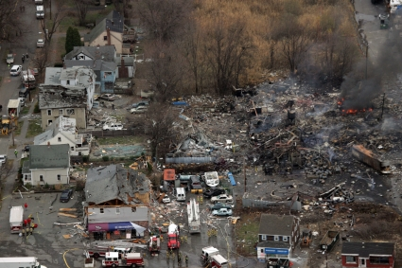
AND ANOTHER!!
Danvers, MA, Nov 2006
Solvent explosion at printing ink factory
US Chemical Safety Board
Hazards known, but defenses compromised by apparently benign change
Latent error in procedure design creates vulnerability to likely execution error

Slide 61
INJURY STATISTICS
According to OSHA…
On the downside:
75% of OSHA citations classified as serious, repeat, or willful.
50 workers are injured every minute.
14 workers die each day.
4.2 million nonfatal injuries and illnesses reported in 2008.
On the up side, with increased safety prevention programs:
Fatality statistics reduced by 50% since 1970.
Injury and illness rates reduced by 40% while employment doubled (56/111 million), and the number of worksites has doubled (3.5/7 million).
Overall fatal work injury rate was lower in 2009 than the rate for any year since the fatality census in 1992.

Slide 62
RISK CONTROL MEASURES
Physical protection
Procedural protection
Educational protection

Slide 63


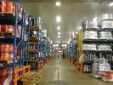

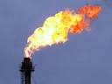
PHYSICAL PROTECTION
Strict & Rigorous approach in following the Relevant Standards , Codes & Practices
Built in Safety Devices and Safety System
Venting through Tall stacks
Field Monitors for Different Toxic Gases
Burning Waste gases in a Flare System

Slide 64
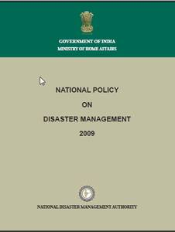

PROCEDURAL PROTECTION
Fire Emergency Procedure
Disaster Preparedness Plan
Mutual Aid Scheme
No Smoking Policy
Investigation of All Accidents
Hazard Identification through Safety audit Committee
Conducting Plant Survey, safety survey
Work Permit System

Slide 65
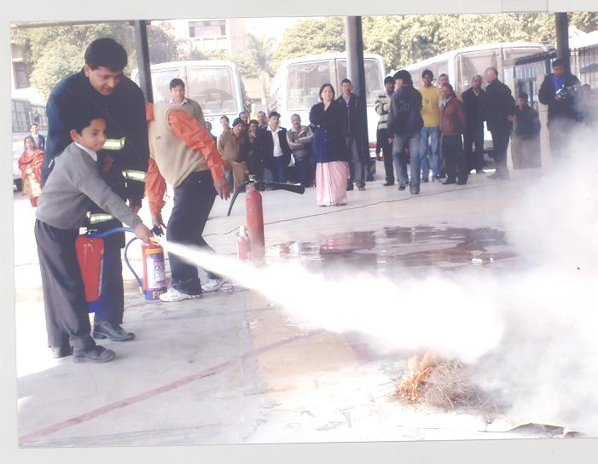

EDUCATIONAL PROTECTION
Periodic Training Program on Safety, Fire Safety and Hazardous properties of materials
Mock Fire Drill
Safety Manuals
Health & Safety News Bulletins, leaflets
Safety Motivation schemes
Plant Operating Manual
Educating the Public Living nearby about the activities in the industry

Slide 66
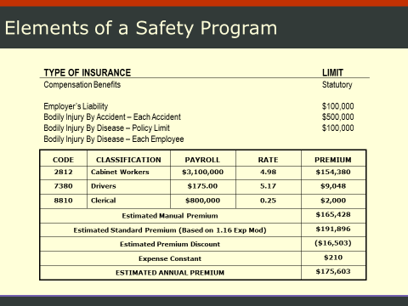

Slide 67

SAFETY AS A PRIORITY
To make safety a top priority in your company, you must…
Remove subjectivity—Use objective tools to quantify savings when implementing a safety program.
Make safety an enterprise value, not just a cost center.
Compete successfully for limited budget dollars.
Change employee health and safety from reactive to proactive.
Take safety out of the back room and put it in the boardroom.

Slide 68
THAT’S ALL FOLKS!!

